Slide 1

DEV OPS PROJECT
By Ashleigh Francis
& Sebastian Hook

Slide 2

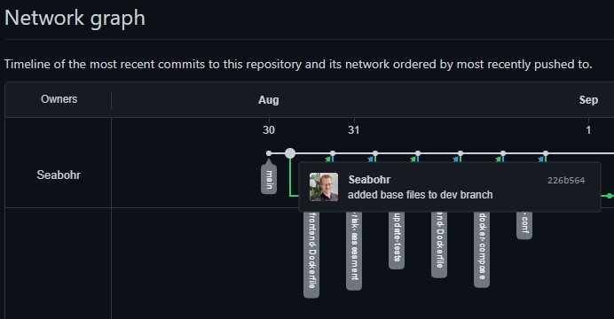
Planning - GitHub

Slide 3
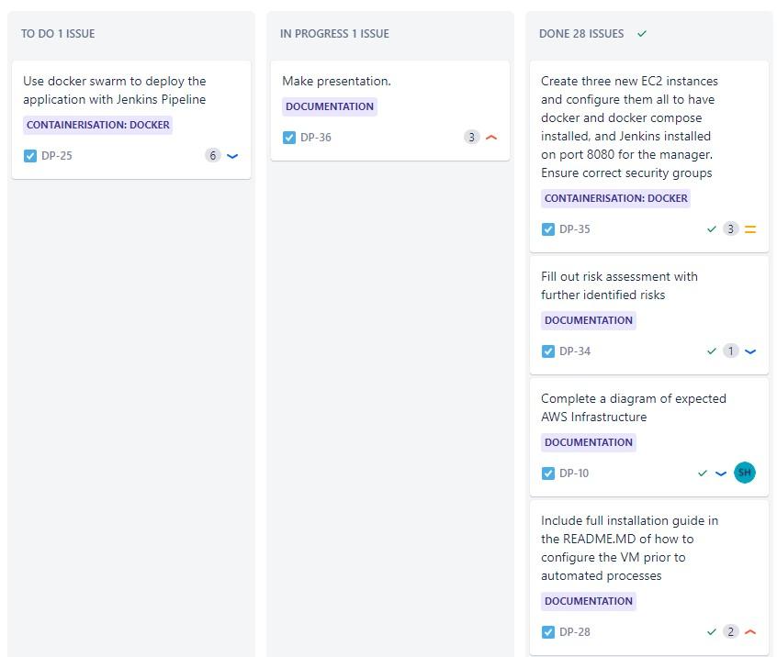
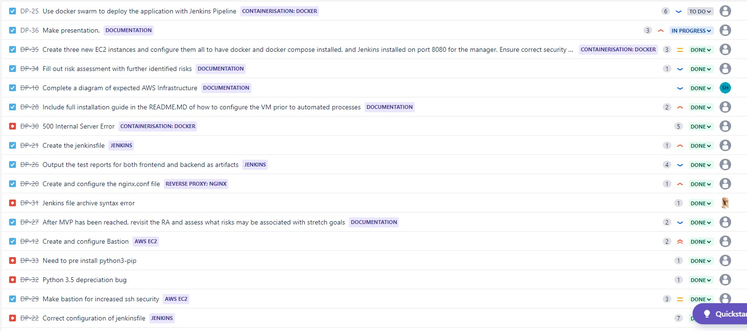
Planning - Jira

Slide 4
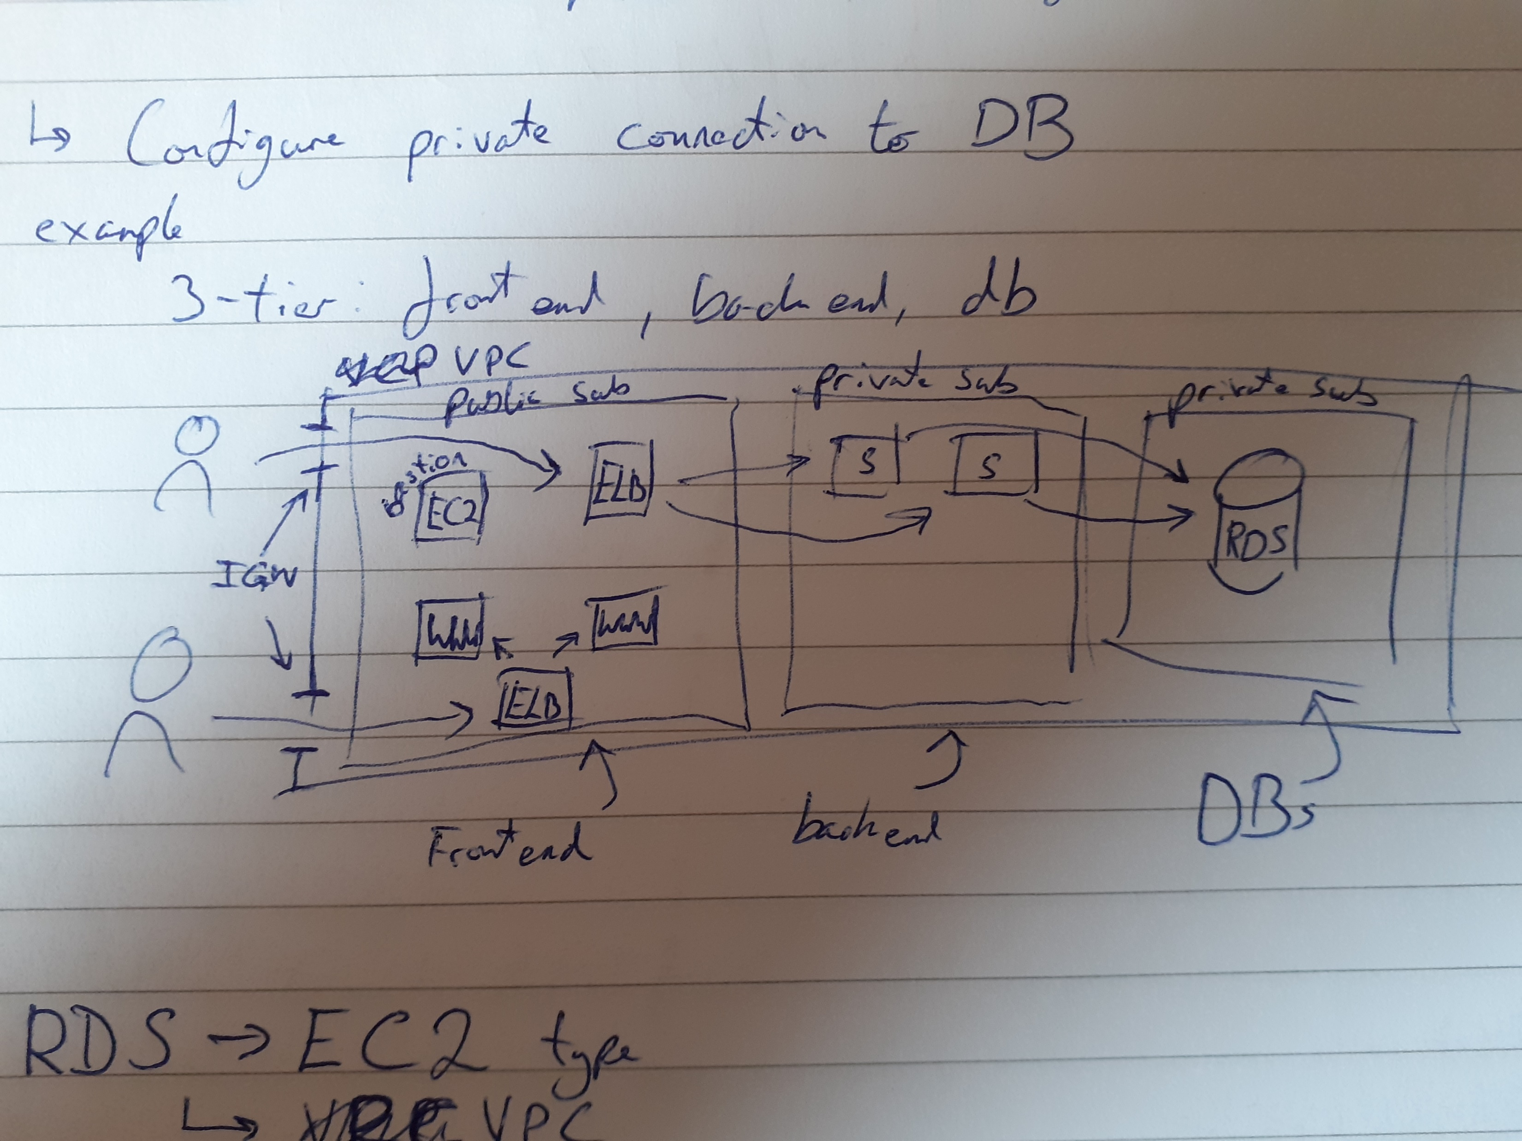
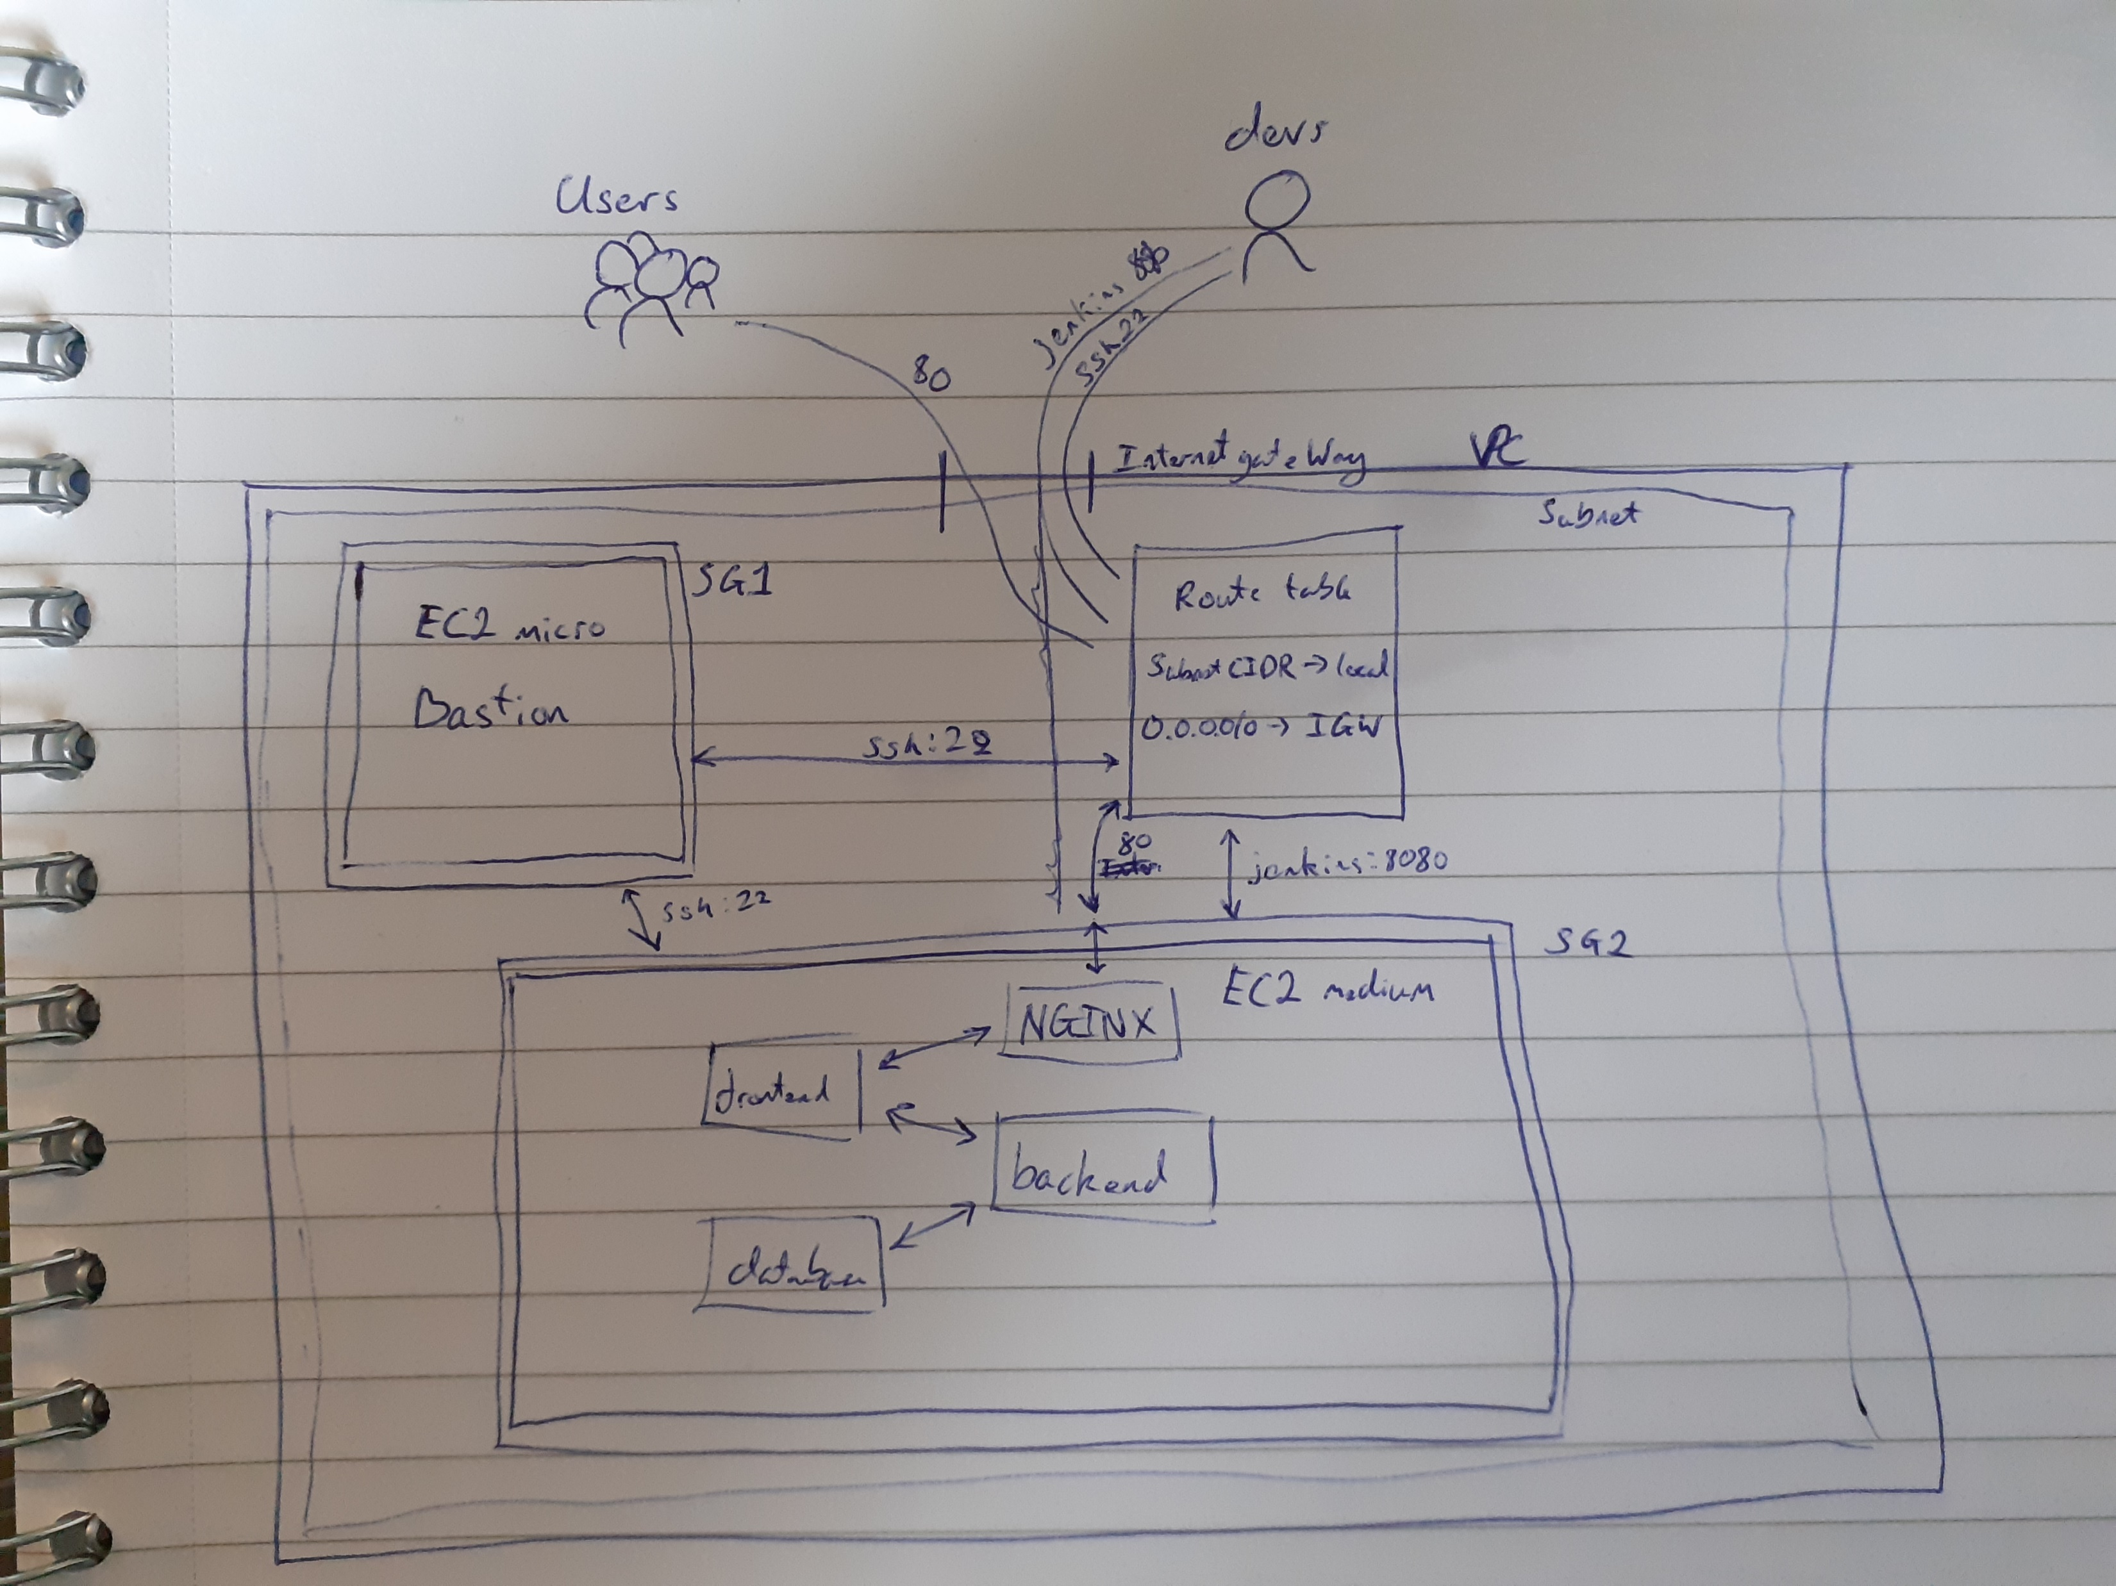
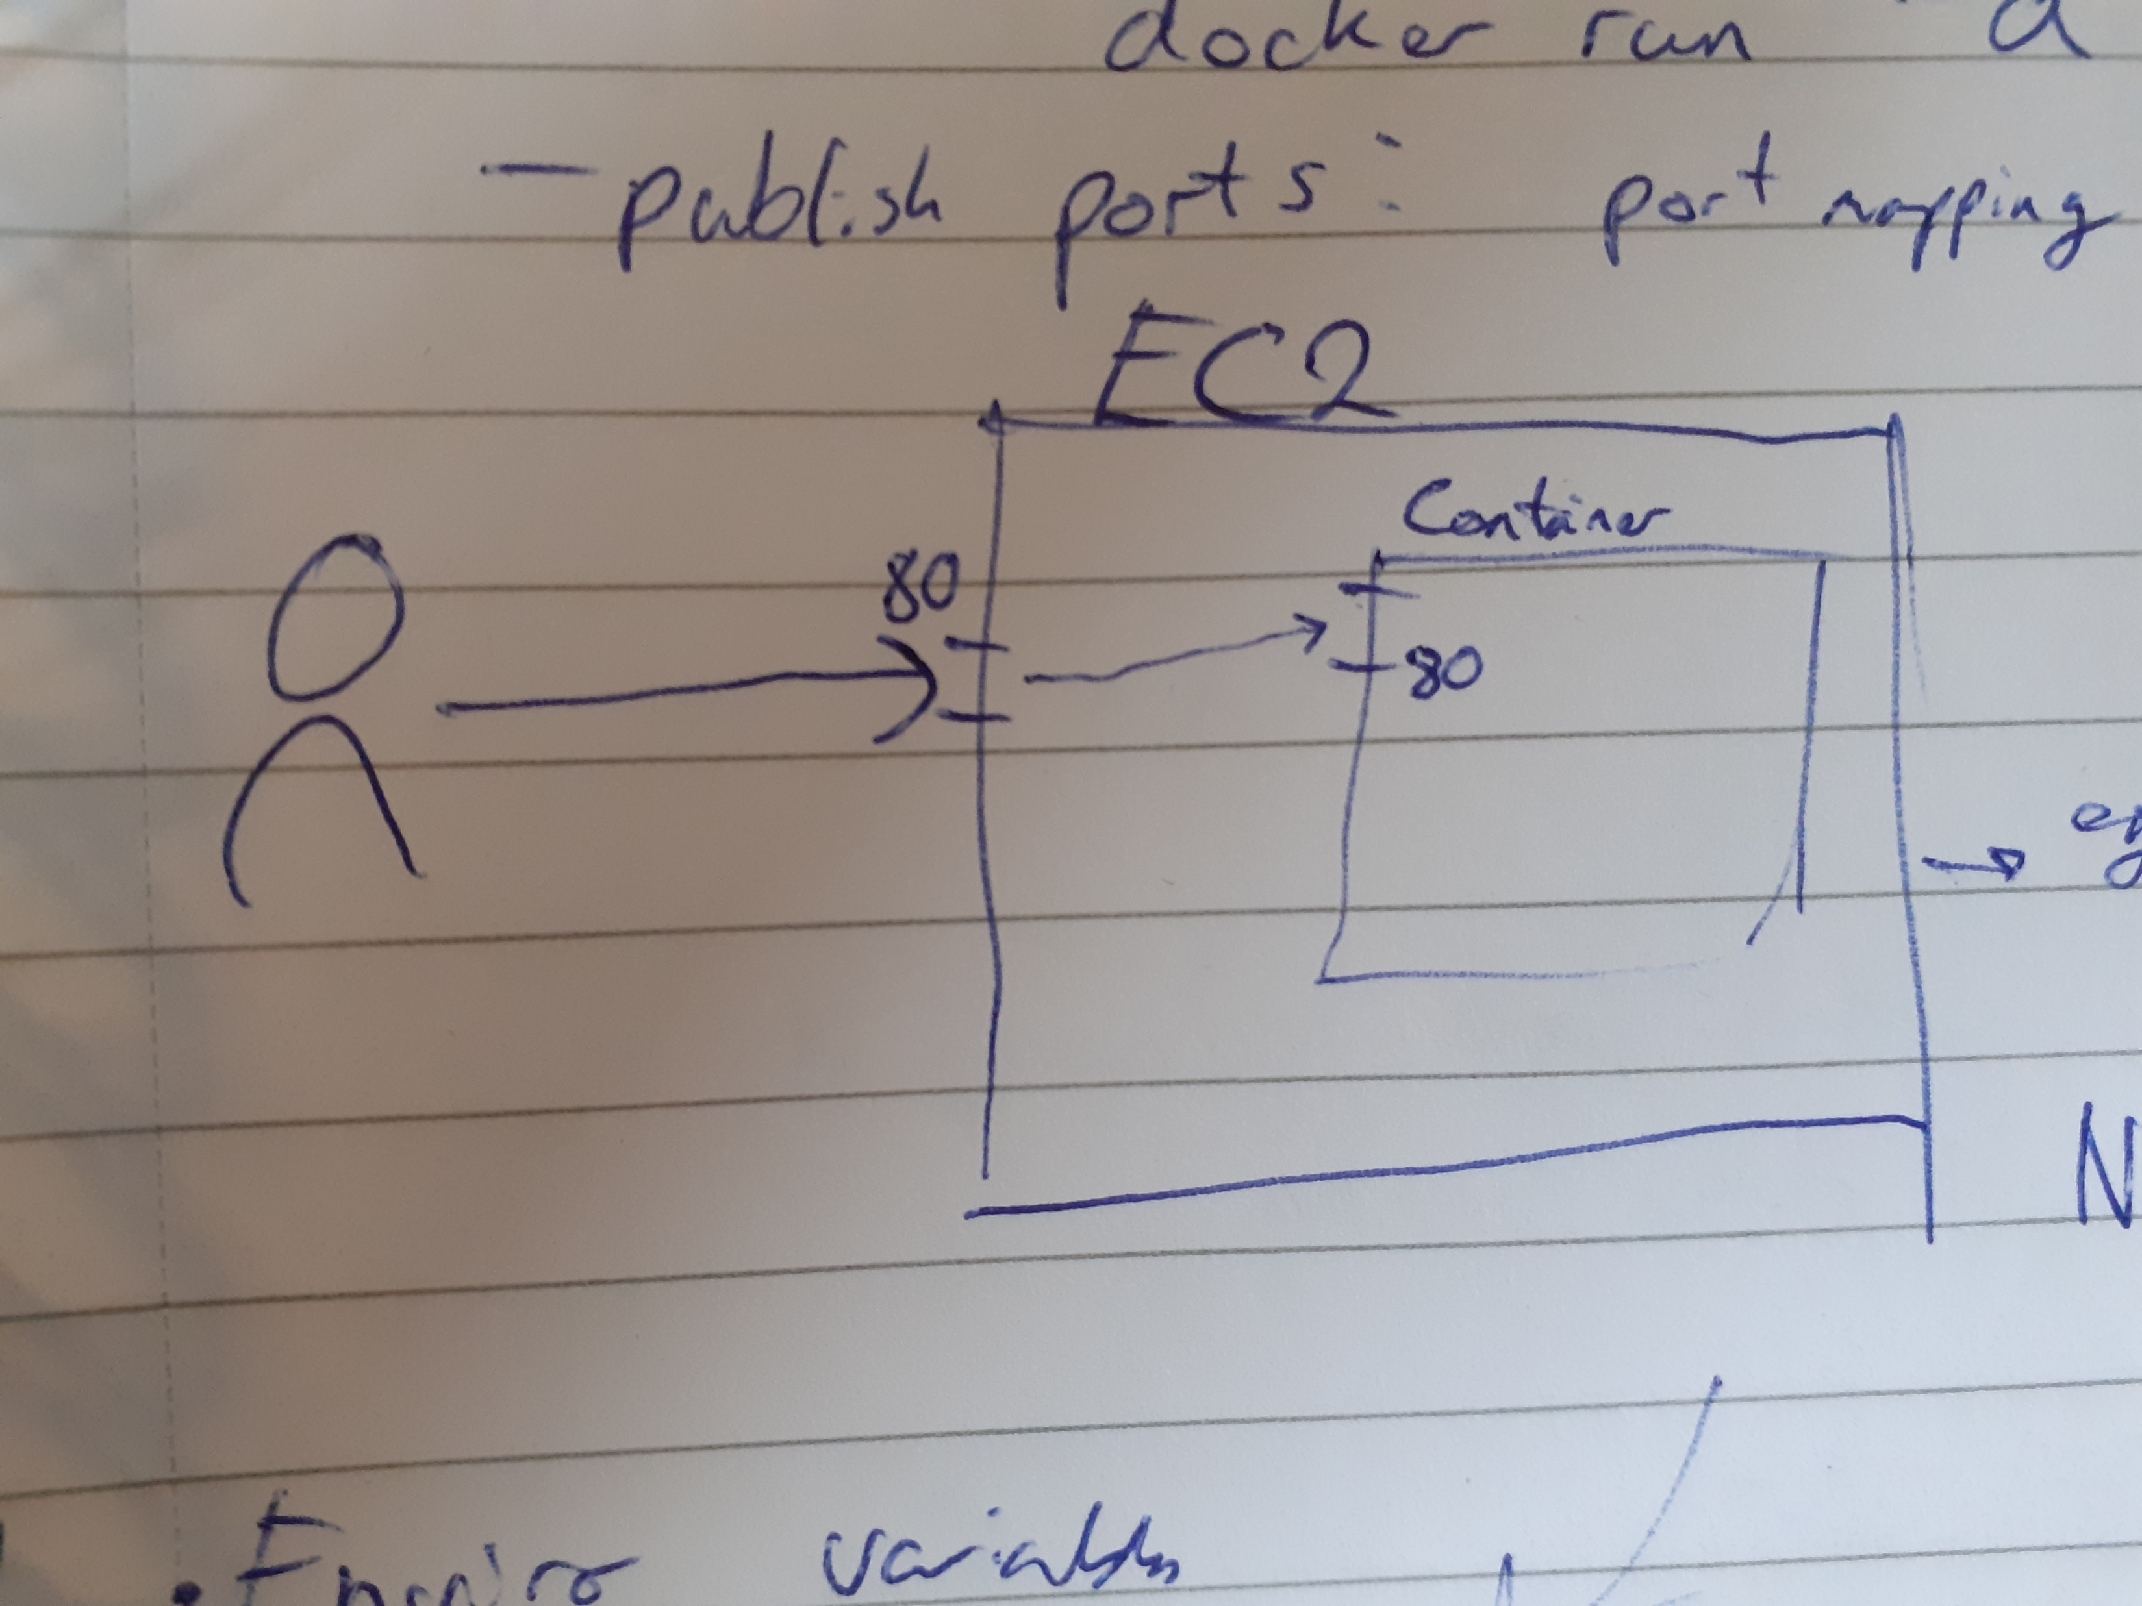
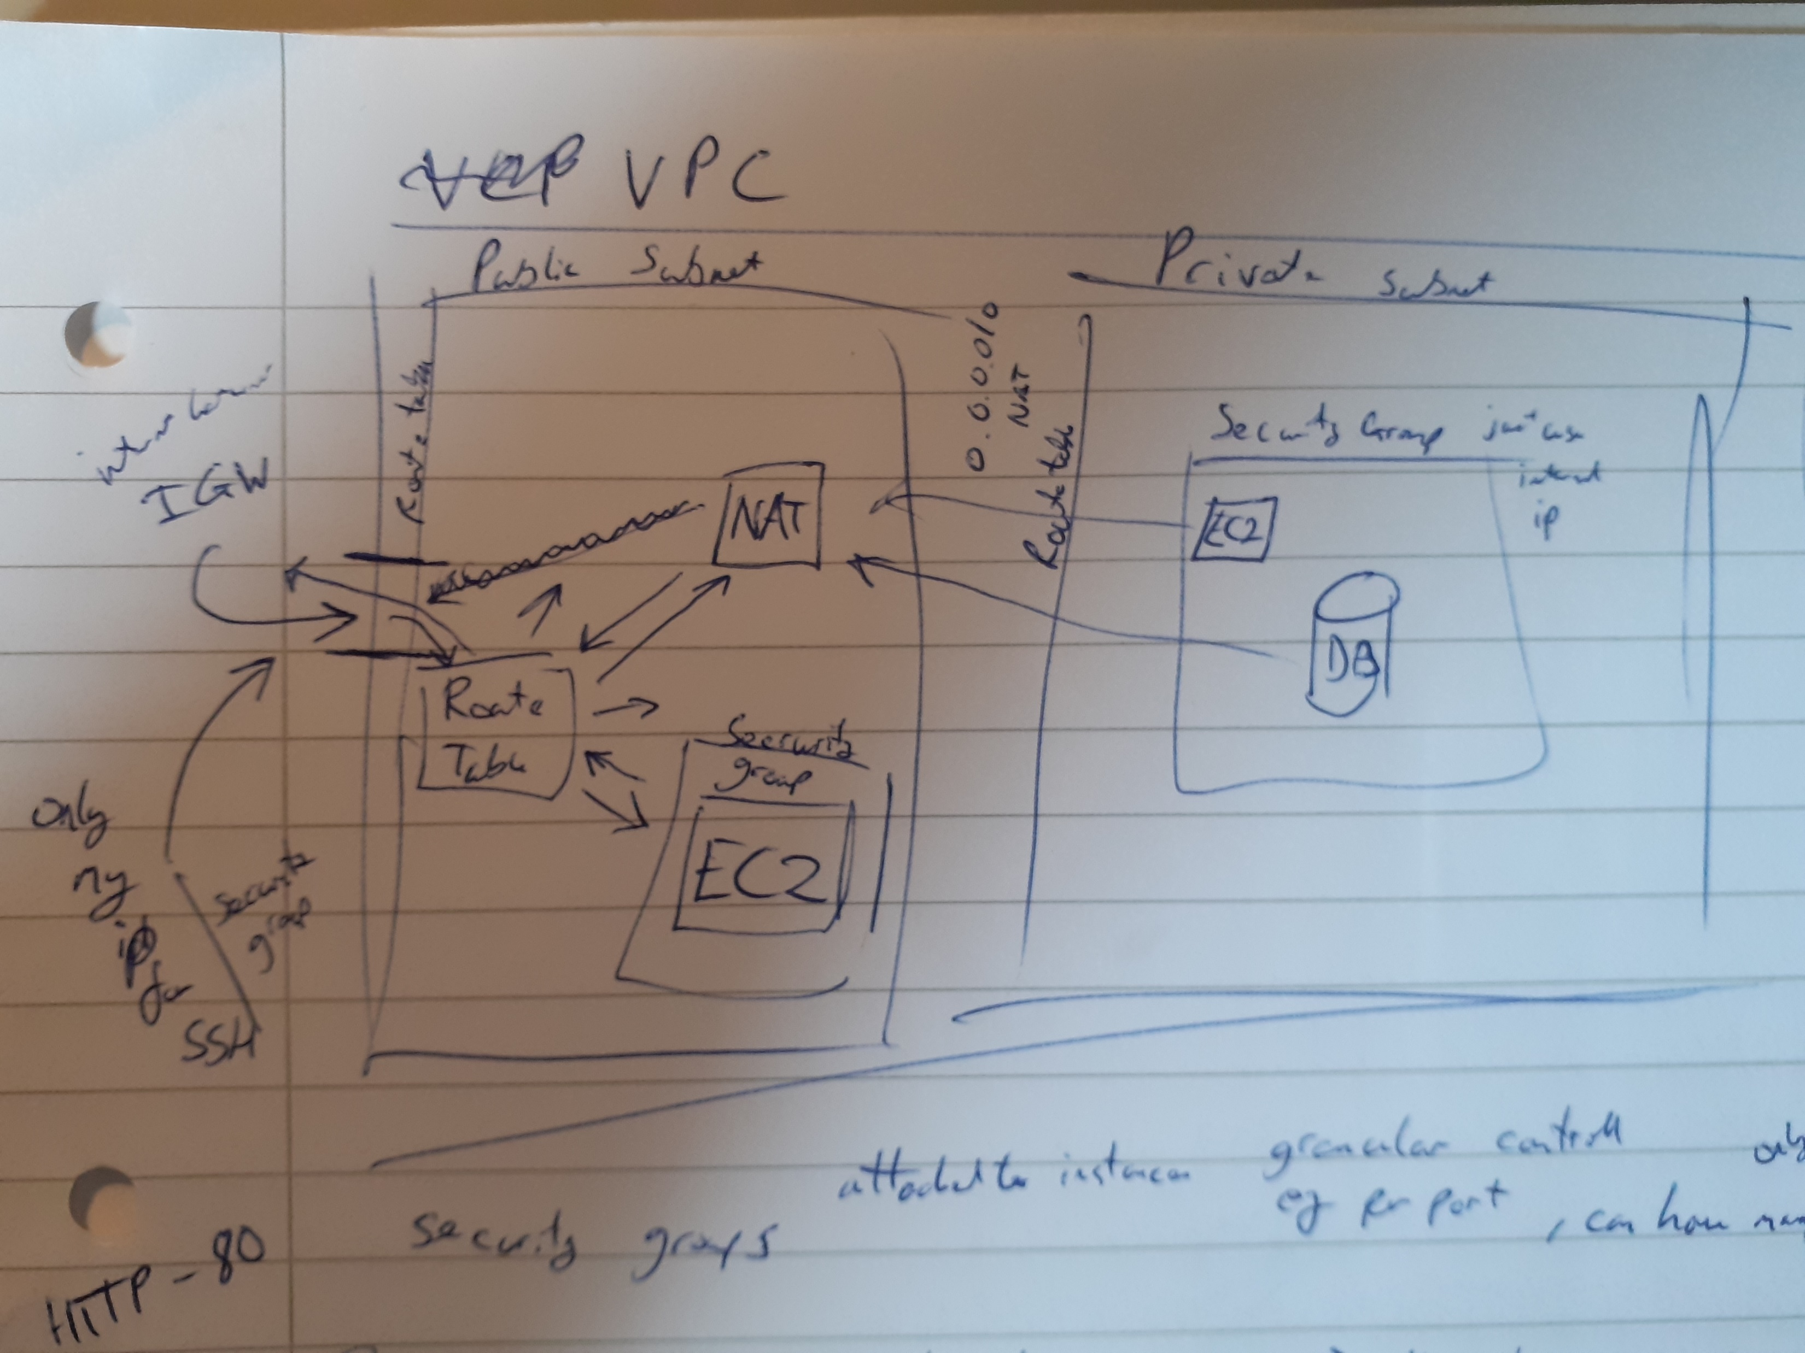
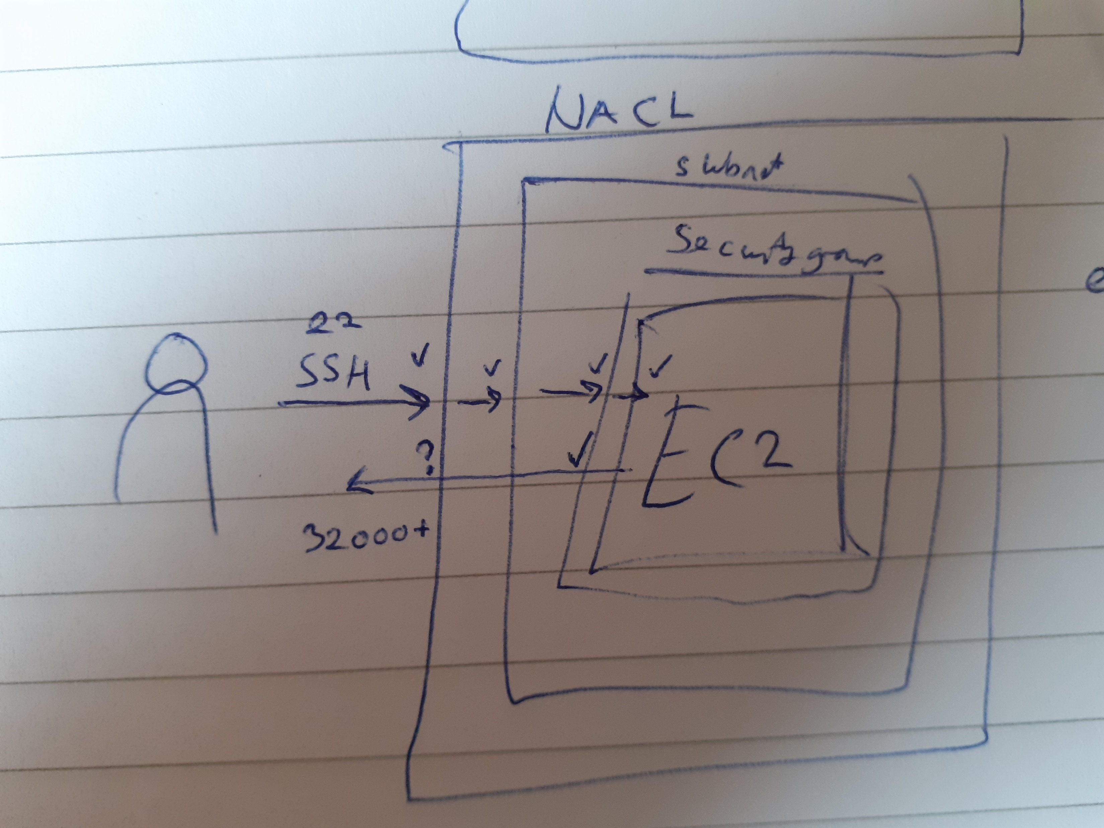
Planning – MVP + Peer Programming
Main goal
MVP
Early structure
Peer Programming
Ensure reliability
Reduce risk of error

Slide 5
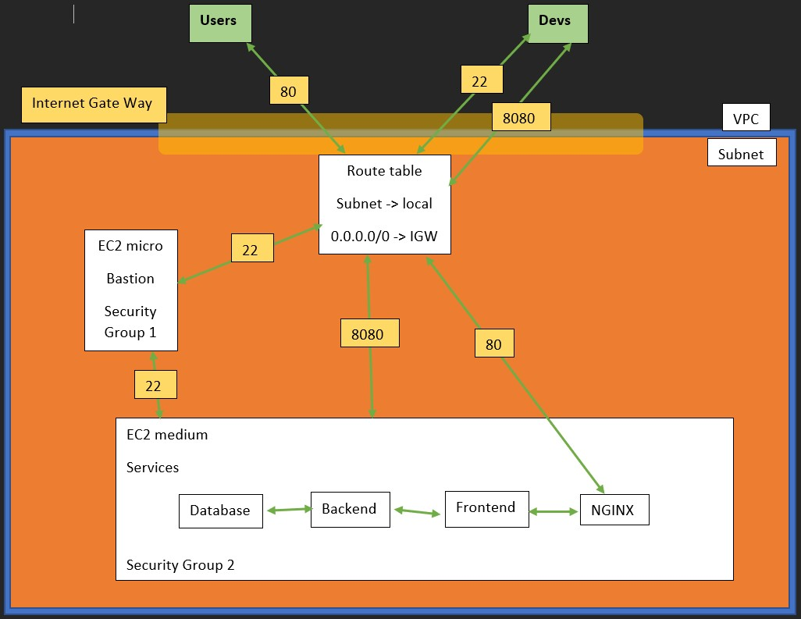
Build

